Slide 1
Environmental Science and
Engineering
(Module – 3,4,5,6)

Slide 2
Course Contents
Module – I- Ecology & Biogeochemical Cycles
Module – II- Environmental gradients & Laws
Module – III- Water & Wastewater Treatment
Module – IV- Atmospheric chemistry, Soil chemistry, Ground water recharge, Noise source & Abatement
Module –V- Solid Waste & Hazardous Waste Management
Module –VI- Environment and Human Health

Slide 3
Module-III
Water & Wastewater Treatment: Water quality standards and parameters, Pre-treatment and Conventional treatment processes of water, DO, BOD, COD, Wastewater Treatment.

Slide 4
Module-IV
Atmospheric chemistry, Soil chemistry, Ground water recharge, Noise source & Abatement: Atmospheric chemistry, Air Pollution, Climate change, Soil chemistry, Water table and Aquifer, Ground water recharge, Noise Standards, Noise measurement, Noise control.

Slide 5
Module-V
Solid Waste & Hazardous Waste Management:
Source, classification and composition of MSW, MSW Management, 3R Principles, Hazardous waste generation and their management, Environment impact Assessment, Origin & procedure of EIA, Project Screening for EIA, Scope studies, Preparation and review of EIS.

Slide 6
Module-VI
Environment and Human Health:
Environment and Human Health, the impact of the IT industry on the environment, including e-waste.
Activities include presentation and report submission by students on environmental problems.

Slide 7
Text Book
An Introduction to Environmental Engineering and Science, by Gilbert M. Masters & Wendell P. Ela, PHI Publication.
Environmental Engineering, by G. Kiely, McGraw Hill International Edition.

Slide 8
Physical Properties of Water
The various physical properties of water that shows wide variation in magnitude includes –
Colour
Turbidity
Taste & odour
Temperature
Solids

Slide 9
Physical Properties of Water
Colour:-
It is measured in Hazen’s Scale.
The permissible limit of colour for drinking water is 5mg/L or ppm.

Slide 10
Physical Properties of Water
Turbidity:-
It is the measure of cloudiness in water & caused by presence of suspended matter which scatters & absorbs light.
It is measured in NTU
(Nephelometric Turbidity Unit)
The Permissible limit of turbidity for drinking water is 1NTU.

Slide 11
Physical Properties of Water
Taste & Odour :-
This may be due to presence of micro-organisms, algae, dissolved minerals, salts etc.
It is measured in TON
(Threshold Odour Number)
The permissible limit of TON for drinking water is 1 to 3.

Slide 12
Physical Properties of Water
Taste & Odour:-
TON = (A + B)/ A
A - Volume of Sample with odour
B -Volume of Pure Water with no odour Added
If A was a 100 ml sample and 100 ml of water had to be added to not detect the odour - the TON would be 2.
TON = (100 + 100)/ 100=200/100=2.

Slide 13
Physical Properties of Water
Temperature:-
The temperature of water varies with atmospheric temperature & it is a significant parameter regarding characteristics of water.
For drinking water the temperature should be 10-25⁰C.

Slide 14
Physical Properties of Water
Solids:-
Solids content of water represents the characteristics of water.
Solids present in water can be studied as follows-
a) Total Solids(TS)
b) Suspended Solids(SS)

Slide 15
Physical Properties of Water
c) Total Dissolved Solids(TDS)
= TS – SS
d) Total Volatile Solids(TVS)
e) Volatile Suspended Solids(VSS)
f) Filterable Solids(FS) & Non-Filterable Solids (NFS)

Slide 16
Physical Properties of Water
NFS = SS
(Particle Size Range is 10⁰ to 10⁻³ mm)
FS can be Colloidal
(Particle Size Range is 10⁻³ to 10⁻⁶ mm) &
Dissolved
(Particle Size Range is 10⁻⁶ to 10⁻⁹ mm)

Slide 17
Chemical Properties of Water
It can be
Inorganic &
Organic

Slide 18
Chemical Properties of Water
Inorganic Chemical properties of water includes –
P^{H}
Alkalinity & Acidity
Hardness
Conductivity

Slide 19
Chemical Properties of Water
Organic Chemical properties of water includes-
BOD
(Biological Oxygen Demand)
COD
(Chemical Oxygen Demand)
TOC
(Total Organic Carbon)
TOD
(Total Oxygen Demand)

Slide 20
Inorganic Chemical Properties of Water
P^{H} is
Potential of Hydrogen or Power of Hydrogen
P^{H} = - log [H⁺] or
= - log [H₃O⁺]
P^{H} range for public water supplies is 6.5 to 8.5.

Slide 21
Problem
In a water treatment plant, the P^{H} values of incoming & outgoing water are 7.2 & 8.4 respectively. Assuming a linear variation of PH with time, determine the average P^{H} value of water.

Slide 22
Inorganic Chemical Properties of Water
Alkalinity & Acidity :-
Alkalinity is also known as ANC or
(Acid Neutralizing Capacity) &
Acidity is also known as BNC or
(Base Neutralizing Capacity)

Slide 23
Inorganic Chemical Properties of Water
Alkalinity can be of
three types.
a) Carbonate Alkalinity
b) Bicarbonate Alkalinity &
c) Hydroxide Alkalinity

Slide 24
Inorganic Chemical Properties of Water
Hardness:-
Hard water has high mineral content.
Hardness of water are of two types:-
a) Temporary Hardness or
Carbonate Hardness
b) Permanent Hardness or
Non-Carbonate Hardness

Slide 25
Inorganic Chemical Properties of Water
a)Temporary Hardness:-
It is due to carbonate & bicarbonate of Ca⁺² & Mg⁺².
b)Permanent Hardness:-
It is due to Chloride & Sulphate of Ca⁺² & Mg⁺².

Slide 26
Inorganic Chemical Properties of Water
Hardness of water is expressed in mg/L as CaCO₃.
The permissible limit of hardness of drinking water is
200 mg/L as CaCO₃.

Slide 27
Inorganic Chemical Properties of Water
Hardness in mg/L as CaCO₃
= [M⁺²(concentration in mg/L) X 50]/ [equivalent weight of M⁺²]
= M⁺²(Concentration in meq/L) X 50

Slide 28
Problem
Determine the various hardness of the following water sample.
Constituent Concentration (in mg/L)
Ca⁺² 60
Mg⁺² 29.3
HCO₃⁻ 366

Slide 29
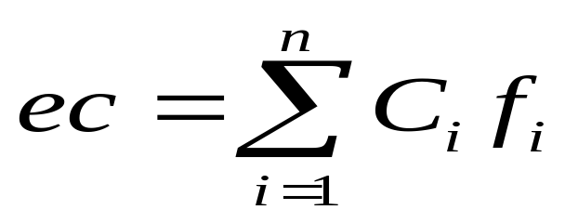
Inorganic Chemical Properties of Water
Conductivity or Electrical Coductivity:-
It is the measure of the ability of an aqueous solution to carry an electric current.

Slide 30
Inorganic Chemical Properties of Water
where,
ec is electrical conductivity in μs(siemens)/cm,
C_{i} is concentration of ionic species in solution in mg/L &
f_{i} is conductivity factor for ionic species.

Slide 31
Organic Chemical Properties of Water
BOD₅ = 0.6 COD
CBOD or
Carbonaceous BOD = 0.92 COD

Slide 32
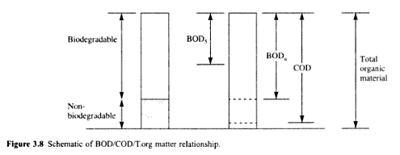
Organic Chemical Properties of Water

Slide 33
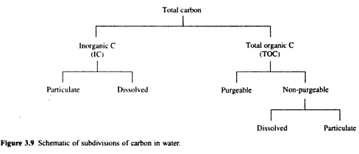
Organic Chemical Properties of Water

Slide 34
Problems
Q.1. Determine COD & TOC for glucose(C₆H₁₂O₆)?
Q.2. If bacteria cells are represented by the chemical formula C₅H₇O₂N, then determine the potential carbonaceous BOD, when bacteria cell concentration is 1000mg/L.

Slide 35
Problems
Q.3. A wastewater is analysed & is shown to contain 100 mg/L of ethylene glycol (C₂H₆O₂) & 120 mg/L of phenol(C₆H₆O). Determine COD & TOC.

Slide 36
Organic content parameter
When an organic waste is discharged to a stream, the organic content of the effluent or discharge undergoes a biochemical reaction with the help of micro-organisms.
The BOD = P(DO_{I}-DO_{F})
Where, P is Dilution Ratio,
DO_{I} & DO_{F} are initial & final DO(Dissolved Oxygen) concentration

Slide 37
Organic content parameter
The Corrected BOD = P[(DO_{I}-DO_{F})-f(B_{I}-B_{F})]
Where, f is the correction factor or seeding factor=1-(1/P),
B_{I} & B_{F} are initial & final DO(Dissolved Oxygen) concentration of seeded diluted water or Blank

Slide 38
Problem
Q. The results from a BOD test diluted by 100 are given below. Calculate the BOD_{S}.
Time (in days) DO(in mg/L)
0 7.95
1 3.75
2 3.45
3 2.75
4 2.15
5 1.80

Slide 39
Problem
Q. The results from a BOD test diluted by 100 are given below. Calculate the Corrected BOD_{S}.
Time (in days) DO(in mg/L) Blank DO(in mg/L)
0 7.95 8.15
1 3.75 8.10
2 3.45 8.05
3 2.75 8.00
4 2.15 7.95
5 1.80 7.90

Slide 40
Organic matter
The rate of decomposition of organic matter is directly proportional to the amount of organic matter available & it is a first order reaction.
i.e. d/dt(L_{t})α L_{t}
=> d/dt(L_{t}) = -k₁xL_{t}
=> d(L_{t})/L_{t}= k₁xdt
Where, L_{t} is BOD remaining in mg/L=BOD_{r} &
K₁ is deoxygenation rate coefficient

Slide 41
Organic matter
Now taking integration of both sides and putting initial condition at t=0, L_{t}=L₀, we will have final expression for BOD exerted at any time t i.e.
BOD_{t}= L₀(1-e^{-k}₁^{t})

Slide 42
Problem
Q. If K₁ or deoxygenation rate coefficient is 0.15 per day, then determine the ultimate BOD or BOD_{u} or L₀.

Slide 43
Temperature effect on K₁
Temperature has an effect on K₁ & is given by,
K_{T} = (K₂₀)x(Ɵ)^{(T-20)}
Where,
K_{T}= The deoxygenation rate coefficient at T⁰C
K₂₀=The deoxygenation rate coefficient at 20⁰C
Ɵ = Coefficient= 1.047 for 20⁰C< T < 30⁰C &
= 1.35 for 4⁰C < T < 20⁰C

Slide 44
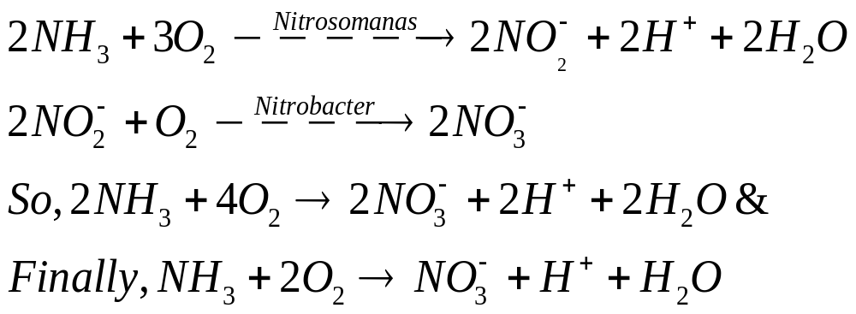
NBOD
The Oxygen demand associated with the oxidation of ammonia(NH₃) to nitrate (NO₃⁻) is called Nitrogenous BOD or NBOD.

Slide 45
Problem
Q. Determine the TOD(Total Oxygen Demand) if the sample contains 25 mg/L of N.

Slide 46
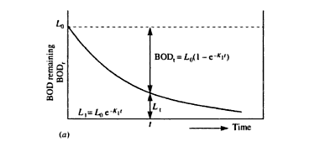
BOD remaining(BOD_{r}) graph

Slide 47
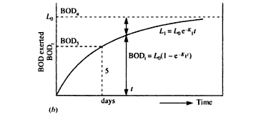
BOD exerted(BOD_{t}) graph

Slide 48
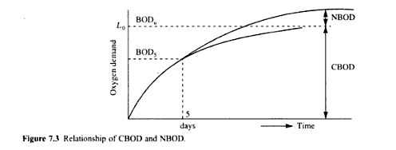
CBOD & NBOD relationship

Slide 49
Problem
Q. 15ml of sample was diluted in 300ml bottle. Initial DO was 8.9 mg/L & final DO after 5days was 4.4mg/L. The corresponding initial & final DO of diluted water was 9.1mg/L & 9.05 mg/L. Find out 5 days BOD at 20⁰C.

Slide 50
Problem
Q. BOD of an sample incubated for one day at 30⁰C was found to be 100mg/L. What would be the 5 day BOD at 20⁰C. The deoxygenation rate coefficient (K₁) is 0.12 at 20⁰C.

Slide 51
Problem
Determine the two day BOD for a wastewater at 20⁰C, while BOD₅ at 20⁰C is 250mg/L. The deoxygenation rate coefficient(K₁) value at 20⁰C is 0.2 per day. What shall be the BOD after the end of seven days at 25⁰C .

Slide 52
Problem
A BOD test was conducted taking 5% wastewater mixed with 95% aerated water for dilution & the following observations were found out:
i) DO of the aerated water used for dilution is 3.6 mg/L
ii) DO of the original wastewater sample is 0.8 mg/L

Slide 53
iii) DO of the diluted wastewater after incubation at 20⁰C for 5 days is 0.7 mg/L
Calculate the 5 days BOD of the above wastewater sample if the deoxygenation constant is 0.11.

Slide 54
Aquatic Pollution
The aquatic Pollution can be classified into three broad groups.
a) Fresh water pollution or
Surface water pollution
b) Estuarine pollution
c) Marine pollution

Slide 55
a)Fresh water pollution
The pollution of fresh water can be caused by:-
Wastes from municipality & industries
Oil from industry wastes & cleaning of vehicles
Thermal waste from industries & power stations
Heavy metals etc.

Slide 56
b) Estuarine pollution
Estuarine means tidal mouth of river or where river mixes with the sea.

Slide 57
c) Marine pollution
The main pollutants for Marine pollution are:-
i) Manmade organic poisons like
Pesticides & herbicides
ii) Radioactivity due to radioactive substances.

Slide 58
Point & Non-Point Sources of Pollution
Point Sources are those, which discharge pollutants from specific locations such as chimney, drainpipe of factories etc.
Point Sources are easier to monitor & regulate.

Slide 59
Point & Non-Point Sources of Pollution
Non-point sources of pollution are those, which don’t have any specific location of discharge.
As a result, these are difficult to monitor & regulate.
Ex:- Run-off from paddy fields, Lawns & Gardens.

Slide 60
Oxygen Sag Curve
The longitudinal profile of Oxygen concentration is Known as Oxygen sag curve.

Slide 61
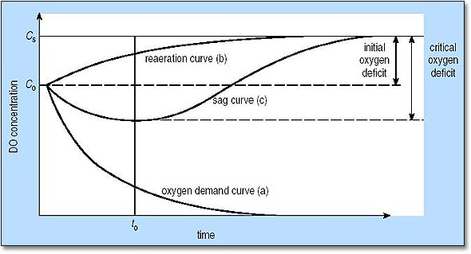
Oxygen Sag Curve

Slide 62
Eutrophication
It can be defined as the enrichment of water by inorganic plant nutrients like N & P, which results in increase in primary productivity.
Artificial eutrophication is known as cultural eutrophication which is caused by adding fertilizers.

Slide 63
Eutrophication
The problems arising due to Eutrophication are:-
Water quality may have unacceptable taste & odour
Water may be injurious to health
The household usefulness of water may decrease.

Slide 64
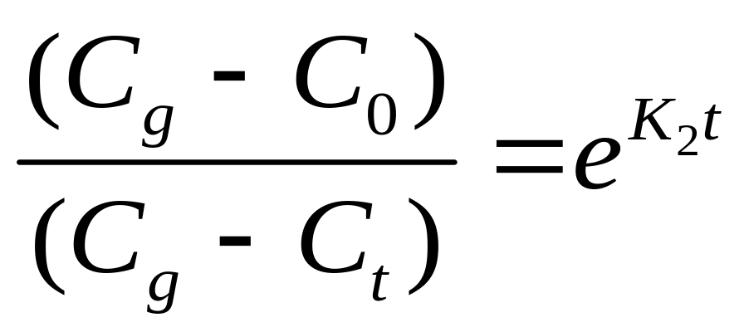
Oxygen transfer in waterbodies
The oxygen transfer in waterbodies is given by Orlob equation i.e.

Slide 65
Oxygen transfer in waterbodies
Where,
C_{g} = Saturation Concentration of oxygen
C₀ = Initial Concentration of oxygen
C_{t} = Concentration of oxygen after time ‘t’
K₂ = reaeration rate constant

Slide 66
Problem
If saturation concentration of oxygen in water is 9.2mg/L & the initial concentration of oxygen is 2.1mg/L, then determine the time it takes to become 7.5mg/L , having K₂ value 0.25 per day. What is the time required for C_{t} to be 5,6,7,8,9 mg/L.

Slide 67
Ground water Quality/Contamination
The most simple model of decay of a contaminant is to assume the decay to be a first order reaction i.e.
r = - kc &
C_{t} = C₀e^{-Kt}

Slide 68
Ground water Quality/Contamination
Where,
C_{t} = Concentration at time ‘t’ in mg/L
C₀ = Initial Concentration in mg/L
t = time in days
K = first order decay coefficient

Slide 69
Problem
Determine the concentration of a contaminant at the downstream well, if the upstream concentration is 80mg/L. Assume decay constant (k) to be 10⁻⁴ per day & time (t) = 274 years.

Slide 70
Ground Water Recharge
It is also known as deep percolation
It is a hydrologic process, where water moves downward from surface to ground.
Recharge can occur both naturally & artificially.
Natural way of recharge is occurred through hydrological cycle.

Slide 71
Ground Water Recharge
Recharge occurs artificially, when rainwater, reclaimed water or recycled water is injected or routed to the subsurface.
Recharge can help move excess salts that accumulate in the root zone to deeper soil layers or into the deep groundwater system.

Slide 72
Ground Water Flow
The ground water flow is governed by Darcy’s law which can be expressed as follows:-
Q = KiA
= KA(dh/dL)
= KA{(h₂-h₁)/(L₂-L₁)}

Slide 73
Ground Water Flow
Where,
Q = horizontal flow in m³/sec
K = hydraulic conductivity in m/sec
i = dh/dL= hydraulic gradient
A = cross sectional area in square mtr

Slide 74
Ground Water Flow
h₂- h₁= water head drop
L₂-L₁ = Length difference over which water head drop occurs
q = Q/A
= Specific discharge or
discharge per unit area

Slide 75
Problem
Determine the daily flow capacity and transmissivity of an aquifer, if it’s height, width, length are 15mtr, 800mtr & 2km respectively. The water head change over the length 2km is 3mtr. The hydraulic conductivity(K) value is 6x10⁻⁷ m/sec.

Slide 76
Water Table
A water table is the underground depth, at which point the ground is totally saturated by water.
The water table may vary due to seasonal changes in precipitation, evapotranspiration & topography etc.

Slide 77
Aquifer
An aquifer is a body of saturated rock through which water can easily move.
An aquifer is an underground layer of water bearing permeable rock from which ground water can be extracted using a water well.
Aquifer can be of two types:-
a) Unconfined aquifer
b) Confined aquifer

Slide 78
Unconfined aquifer
An unconfined aquifer is the one which is open to receive water from the ground surface & whose water table surface is free to fluctuate up & down, depending on the recharge & discharge rate.
These are extremely susceptible to contamination.

Slide 79
Confined aquifer
These type of aquifers have rock layer with less permeability or confining bed of rock above them due to which water can’t enter freely into these type of aquifers from the ground surface.
These are less susceptible to contamination.

Slide 80
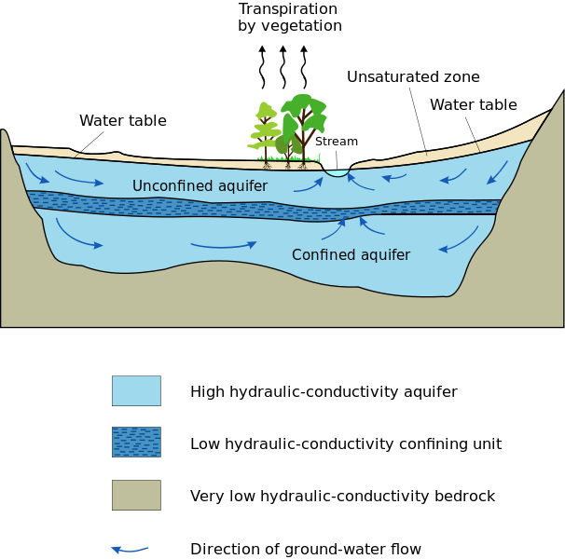
Figure

Slide 81
Concept of Hydrology
i)Water Balance or Water Budget
ii)Hyetograph & Hydrograph
iii)Rainfall-Runoff Relationship or
Rational formula for determining runoff

Slide 82
Concept of Hydrology
i)Water Balance or Water Budget:-
It gives the quantitative account of hydrological cycle.
The equation for water balance is based on conservation of mass.

Slide 83
Concept of Hydrology
The water balance equation is
P= R+E+∆S+∆G
Where, P is Precipitation
R is Runoff
E is Evaporation
∆S is change in soil moisture status
∆G is change in ground water status

Slide 84
Concept of Hydrology
ii) Hyetograph & Hydrograph :-
Hyetograph represents rainfall intensity vs time.
Hydrograph represents runoff or stream discharge vs time.
If time is unit i.e. 1hr., then hydrograph will be unit hydrograph.

Slide 85
Concept of Hydrology
iii)Rainfall-Runoff Relationship or
Rational formula for determining runoff :-
Q=CIA
Where,Q is runoff in m³/sec
C is locality coefficient
I is Rainfall Intensity in mm/hr
A is Catchment Area in square Km

Slide 86
Concept of Hydrology
Peak Discharge (Q_{P})or Peak Run-off can be expressed as follows:-
Q_{P}=0.278 CIA
Modified Rational Formula given by Wallingford is :-
Q_{P}=0.278C_{V}C_{R}IA
Where, C_{V} is volumetric runoff coefficient &
C_{R} is Routing Coefficient

Slide 87
Water Treatment
The objectives of water treatment are :-
A) To produce Water which is safe for human consumption
B) To produce Water at a reasonable cost
C) To reduce water impurities to acceptable levels

Slide 88
Organoleptic Parameters
Organoleptic Parameters are those parameters which can be sensed or felt by human organs.
Ex:- Colour, Taste & Odour etc.

Slide 89
Classes of Water treatment
Class Descripition Source
A No Treatment Borehole water
B Disinfection only Borehole water
C Standard water Treatment River,Reservoir
D Advanced/Special water Industrial Water
Treatment

Slide 90
Monitoring Frequency
The water quality parameters are required to be monitored depending on the source & quality of raw water.
The three categories are:-
A) Minimum monitoring(C1)
B) Current monitoring(C2)
C) Periodic Monitoring(C3)

Slide 91
Water Treatment Processes
The treatment processes of water can be classified into three stages :-
A) Pretreatment processes
B) Standard or Conventional processes
C) Special or Advanced processes

Slide 92
A) Pretreatment processes
Some treatment processes are required prior to standard water treatment processes which may include :-
i) Screening
ii) Storage
iii) Aeration
iv) Chemical pre-treatment

Slide 93
A) Pretreatment processes
i) Screening:-
Different types of screens are used in this process. Those are can be :-
a)Coarse Screen
b)Fine Screen
c)Micro Screen

Slide 94
A) Pretreatment processes
a) Coarse Screen:-
These screens contain typically inclined bars of 25mm dia & 100mm spacing, preventing large floating matters from entering the treatment plant

Slide 95
A) Pretreatment processes
b) Fine Screen:-
If storage is not provided, then fine screens are fitted after the coarse screens.
If there is storage, then fine screens are placed at the outlet of the storage tanks.
Fine screens are typically mesh with openings about 6mm dia or square

Slide 96
A) Pretreatment processes
C) Micro Screen:-
In micro screens, mesh openings range from 20 to 40 µm.
These type of screens are used only for relatively uncontaminated water.

Slide 97
A) Pretreatment processes
ii) Storage:-
Storage tanks balance the flows going to the treatment plant.
Storage capacity should be equivalent to 7 to 10 days of the average water demand.
The period of storage shouldn’t be long, so as not to encourage the growth of unwanted organisms

Slide 98
A) Pretreatment processes
iii) Aeration:-
Aeration is the supply of oxygen from the atmosphere to water to effect beneficial changes in the quality of water.
It is a common treatment process for groundwater

Slide 99
A) Pretreatment processes
Aeration is generally used for the followings:-
a) To release excess H₂S gas which may cause undesirable taste & odour.
b) To release excess CO₂ which may have corrosive properties
c) To increase oxygen content of water.

Slide 100
A) Pretreatment processes
iv) Chemical pre-treatment:-
The chemical pre-treatment to remove undesirable properties of water like algae or excess colour is a more expensive process than chemical post-treatment.
In pre-treatment, greater amount of chemicals are required to effect the same result as some of the chemicals are absorbed by turbidity of water.

Slide 101
A) Pretreatment processes
The two Chemical pre-treatment processes which are generally used are:-
a) Pre-Chlorination
b) Activated Carbon

Slide 102
A) Pretreatment processes
a) Pre-chlorination:-
It is used on low turbidity water with a high coliform count. The chlorine is injected into the water stream & it oxidizes & precipitates iron & manganese. It also kill pathogens & reduces colour. The chlorine dose used is 5mg/L. Pre-chlorination also reduces NH₃ in both surface water & ground water supplies.

Slide 103
A) Pretreatment processes
b) Activated Carbon:-
The activated Carbon is used for:-
i) Removal of Photosynthetic Algae
ii) Improvement of colour & odour
iii) Removal of organic compounds

Slide 104
A) Pretreatment processes
Activated Carbon can be used either as PAC (Powdered Activated Carbon) or as GAC (Granular Activated Carbon).
Generally for water treatment PAC is used, but GAC is used where taste & odour of water have an industrial base.
PAC has lower cost & efficiency than GAC.
Doses may vary from 3 to 20 mg/L.

Slide 105
B) Standard or Conventional processes
It includes:-
i) Sedimentation
ii) Coagulation
iii) Flocculation
iv) Filtration &
V) Disinfection

Slide 106
B) Standard or Conventional processes
i) Sedimentation:-
The heavier large particles settle down by the force of gravity at the bottom of the sedimentation tank, which is called Sedimentation.
Stoke’s law for settling velocity is the deciding force for sedimentation.

Slide 107
B) Standard or Conventional processes
Stoke’s law can be represented by:-
V_{S}=(g/18µ)(ρ_{s}- ρ_{w})d²
Where, V_{S} is settling velocity
g is acceleration due to gravity
µ is dynamic viscocity
d is dia of settling particle
ρ_{s} is density of particle settling
ρ_{w} is density of water

Slide 108
B) Standard or Conventional processes
ii) Coagulation:-
The lighter smaller particles don’t settle down by the force of gravity.
To make them settle down, some amount of coagulants are added to the water, which is called Coagulation.

Slide 109
B) Standard or Conventional processes
Some examples of coagulants are:-
Alum i.e. aluminium sulphate
Ferric Chloride
Ferric Sulphate
Ferrous Sulphate

Slide 110
B) Standard or Conventional processes
iii) Flocculation:-
When coagulants are added to the water, the lighter smaller particles coagulate or combine with each other forming bigger particles, known as floc & the process is called flocculation.

Slide 111
B) Standard or Conventional processes
iv) Filtration:-
It is the process of passing water through a porous medium, with the expectation that the filtrate water has better quality than the incoming water.

Slide 112
B) Standard or Conventional processes
Generally, two types of filters are used
a)Rapid gravity filter:-
Here rate of filtration is high i.e. 5 to 20m/hr.
b) Slow sand filter:-
Here rate of filtration is slow i.e. 0.1 to 0.2m/hr.

Slide 113
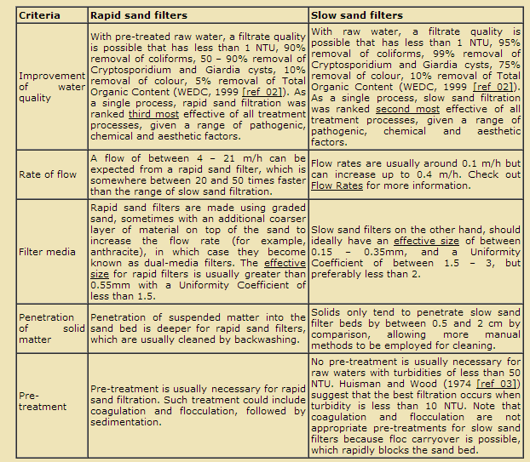
Comparision

Slide 114
B) Standard or Conventional processes
V) Disinfection:-
By disinfection, pathogens & micro-organisms are killed, thereby making water more pure.
The requirements of a good disinfectant are-
a) It should be toxic to micro-organisms.
b) It should have a fast rate of kill.

Slide 115
B) Standard or Conventional processes
c) It should be persistent enough to prevent regrowth of organisms in the distribution system.
d) It shouldn’t produce undesirable compounds.
e) It should be safe to handle.
f) It should be of reasonable cost.

Slide 116
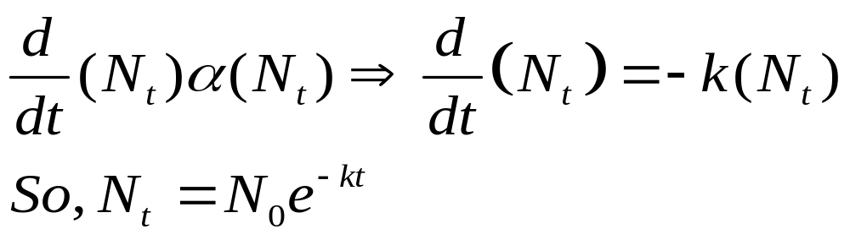
B) Standard or Conventional processes
Chick’s law:-
The rate of destruction of micro-organisms is often a first order chemical reaction as given by Chick’s law i.e.

Slide 117
B) Standard or Conventional processes
Where,
N_{t} = Number of organisms at time ‘t’
N₀ = Number of organisms at time ‘t’= 0
K = Rate constant depends on types of micro-organisms present & types of disinfectants used

Slide 118
B) Standard or Conventional processes
The various examples of disinfectants are:-
a) Chlorine dioxide
b) Chlorination
c) Chloramines
d) UV radiation

Slide 119
Chlorine demand & Breakpoint Chlorination
When chlorine is added to water, the chlorine at first oxidizes inorganic compounds & some amount of chlorine will be consumed by organic matter present in water. Then some amount of chlorine will be used for formation & subsequent destruction of chloramines.

Slide 120
Chlorine demand & Breakpoint Chlorination
The amount of chlorine required to fulfill the above consumption requirements are called chlorine demand.
The point at which the chlorine demand is satisfied is called the breakpoint chlorination.

Slide 121
Chlorine demand & Breakpoint Chlorination
The excess dose of chlorine after breakpoint, is available for disinfection which appears as residual chlorine.
A residual chlorine of minimum 0.5mg/L is maintained in disinfection practices.

Slide 122
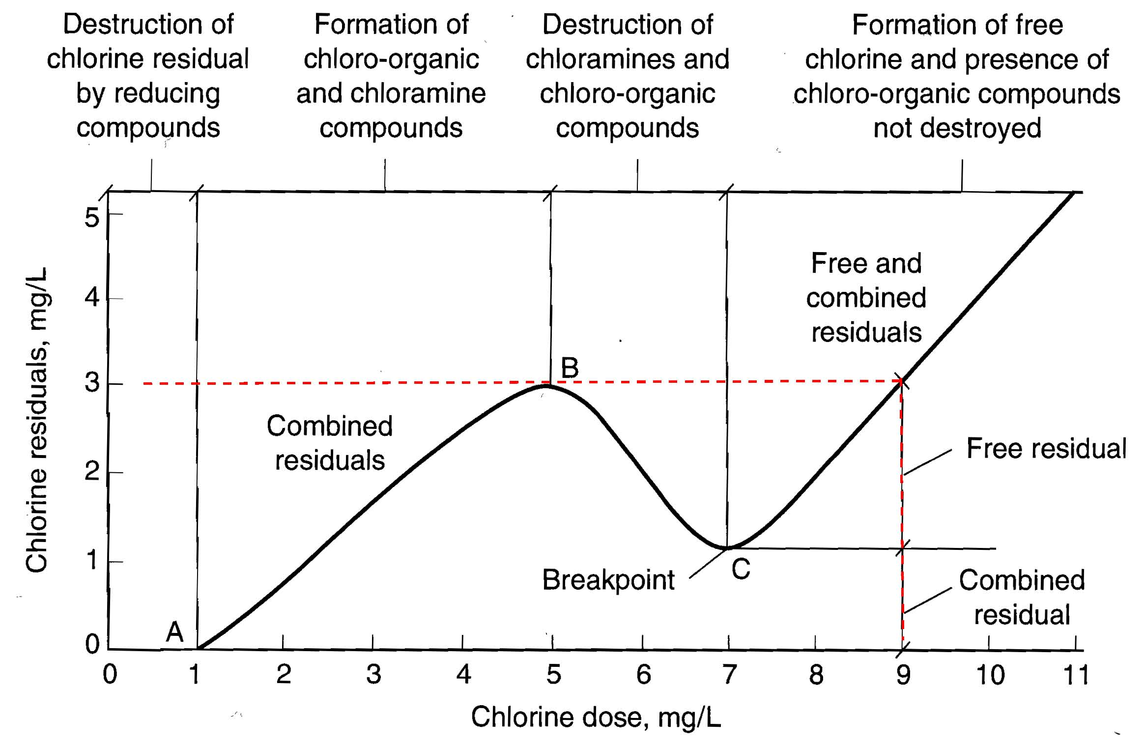
Chlorine demand & Breakpoint Chlorination

Slide 123
C) Special or Advanced processes
The purposes of advanced water treatment processes are:-
i) To take water treated by standard water treatment processes & to improve it to an exceptionally high quality water as often required by particular industries like food industry & pharmaceuticals etc.

Slide 124
C) Special or Advanced processes
ii) To treat water containing specific chemical or microbiological contaminants, so that they can be brought to an acceptable standard.

Slide 125
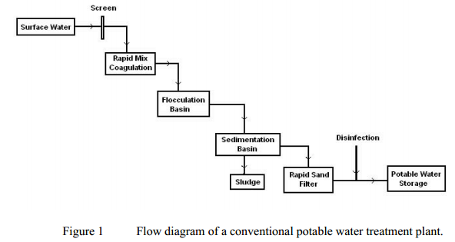
Flow Diagram

Slide 126
Wastewater Treatment
Introduction:-
Generation of wastewater is based on our water consumption rate, which is increasing & the way we use water.
As undesirable contaminants are likely to be present in the wastewater, it can contaminate or degrade our surface water or ground water resources, hence it should be properly treated before releasing to the water bodies or environment.

Slide 127
Types of wastewater
a) Domestic/Sanitary wastewater
b) Industrial wastewater
c) Agricultural wastewater
d) Storm/Runoff water

Slide 128
Common Terms
Sewage:- It refers to domestic / sanitary wastewater.
Sewer:- It refers to pipes carrying sewage.
Sewerage:- It refers to sewer network systems.
FOG:- It refers to Fat, Oil & Grease, which are basically immiscible layer in the wastewater.

Slide 129
Wastewater Treatment Processes
a) Pre-treatment
b) Primary treatment
c) Secondary or Biological treatment

Slide 130
a) Pre-treatment
Pre-treatment of municipal wastewater is required to make it useful for further treatment & to decrease overall load on the system.
It includes Screening, Grit Channels, Oil & Grease removal, Chemical pre-treatment etc.

Slide 131
b) Primary treatment
It basically removes suspended solids(SS) from the wastewater.
Sometimes, it also removes some organic solids along with inorganic suspended solids.
It includes sedimentation, coagulation etc.
The removal efficiency w.r.t. SS is 50-70% and w.r.t. removal of BOD is 25-40%.

Slide 132
c) Secondary or Biological treatment
It can be divided into two major categories, depending on the availability of oxygen.
i) Aerobic Process
i.e. it occurs in presence of oxygen &
ii) Anaerobic Process
i.e. it occurs in absence of oxygen.

Slide 133
c) Secondary or Biological treatment
Aerobic Processes like Trickling Filter, RBC(Rotating Biological Contactor) & ASP(Activated Sludge Process) etc.
Anaerobic process has three major steps like Hydrolysis, Acidogenesis or Fermentation & Methanogenesis.

Slide 134
ASP(Activated Sludge Process)
It is an excellent method of treating either raw sewage or more generally the settled sewage.
The sewage discharged from the primary sedimentation tank, which is normally used in this process, is mixed with 20 to 30% of activated sludge, which contains a large concentration of highly active aerobic micro-organisms, which increases the rate of decomposition.

Slide 135
ASP(Activated Sludge Process)
The ASP unit basically consists of CSTR (Continuously Stirred Tank Reactor), which is an aeration basin equipped with surface aerators and secondary clarifier unit.
The aerobic bacteria culture is developed in the reactor and remain in suspension.

Slide 136
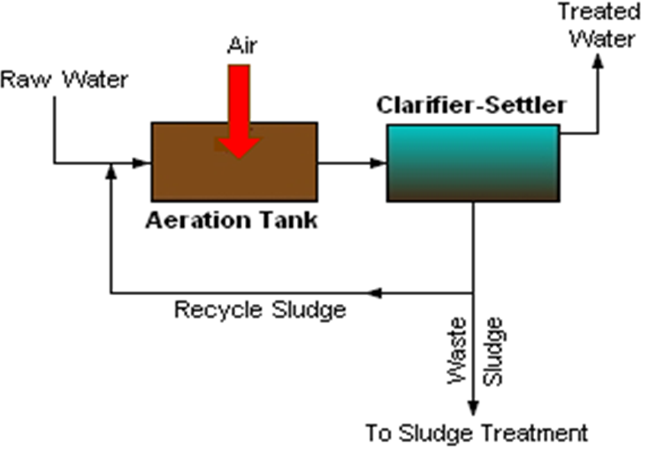
ASP(Activated Sludge Process)

Slide 137
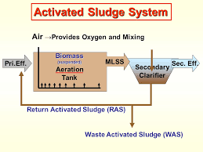
RAS, WAS & MLSS(Mixed Liquor Suspended Solids)

Slide 138
Monod Model
Monod Kinetics is used for microbial growth calculations, and reactor sizing, in the activated sludge process.
The pertinent equations are r_{g} = dX/dt = μ X = μ_{max} SX / (K_{s} + S) , where the terms have the usual meanings, S, substrate conc, X, microbe conc.
The diagram below shows how K_{s} is determined from μ_{max} . Monod's equation is an empirical equation to determine r_{g} , the growth rate of microbes.

Slide 139
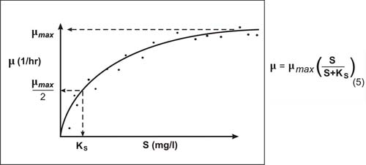
Monod Model

Slide 140
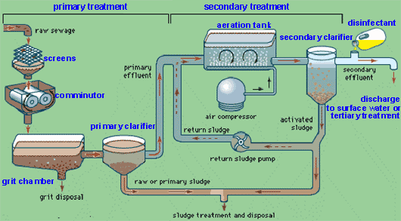
wastewater treatment flow diagram

Slide 141
Aerobic vs Anaerobic Process
In aerobic process, molecular oxygen present which is absent in case of anaerobic process.
In aerobic process, stable oxidized end products like CO2 & H2O are generated, but in case of anaerobic process stable reduced end products like CH4 & NH3 are generated.
In aerobic no byproduct recovery, but in anaerobic byproduct methane gas is useful.

Slide 142
Aerobic vs Anaerobic Process
In aerobic appreciable microbial growth occurs, but in anaerobic no appreciable growth of microbes.
In aerobic less skilled operation & in anaerobic more skilled/stringent operation is required.
In aerobic low capital cost but high operating cost & in anaerobic high capital investment but low operating cost.

Slide 143
Aerobic vs Anaerobic Process
Aerobic process is suitable for low BOD wastewater like sewage while anaerobic process is suitable for high BOD wastewater/ sludge coming from sugar mills and other agrochemical operations.

Slide 144
Reactor Configuration
In environmental engineering, particularly in water & waste water treatment reactors used are of 3 types –
i) Batch Reactor(BR)
ii) Continuously Stirred Tank Reactor(CSTR)
iii) Plug Flow Reactor(PFR)

Slide 145
i) Batch Reactor(BR)
In this case, the reactants or inputs enter into the reactor, remain for desired time & then discharged.
Ex:- BOD test

Slide 146
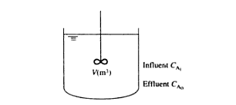
Diagram of BR

Slide 147
ii) Continuously Stirred Tank Reactor(CSTR)
In this case, reactants continuously enter into the reactor & the products are continuously discharged from a well-mixed vessel.
Ex:- Waste water treatment

Slide 148
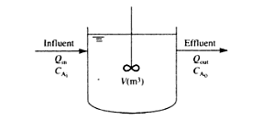
Diagram of CSTR

Slide 149
iii) Plug Flow Reactor(PFR)
In this case, the reactants or inputs are entered at one end & products are discharged at the other end, after spending a minimum retention time in the system.
Ex:- mixing of pollutant in river flow

Slide 150

Diagram of PFR

Slide 151
Soil Chemistry
The order of 10 most abundant elements in soil & crustal rocks are –
In soil :
O > Si > Al > Fe > C > Ca > K > Na > Mg > Ti
In Crustal rock :
O > Si > Al > Fe > Ca > Mg = Na > K > Ti > P

Slide 152
Soil Chemistry
The most common soil minerals are –
Quartz - SiO₂
Calcite - CaCO₃
Gypsum - CaSO₄.2H₂O
Gibbsite - Al(OH)₃

Slide 153
Soil Chemistry
Soil Salinity :-
A soil solution is considered saline, if the electrical conductivity (EC) is greater than 4000 micro-siemens/cm or µs/cm.
This condition occurs, when evaporation exceeds precipitation.
If this condition continues then, saltpan will occur.

Slide 154
Soil Chemistry
General Composition of soil :-
1)Inorganic or Mineral matter–45% (Ca,Mg etc.)
2) Organic matter – 5% (Humus)
3) Soil water – 25%
4) Soil air – 25%

Slide 155
Soil Chemistry
Types of soil in India :-
1. Red soil
2. Black soil
3. Mountainous soil
4. Desert soil
5. Alluvial soil
(fine grained fertile soil present in river bed)

Slide 156
Soil Chemistry
The elemental properties of soil in relation to infiltration are –
1. Bulk Density or Dry Density
2. Particle Density
3. Porosity
4. Water content
5. Degree of saturation

Slide 157
Soil Chemistry
Bulk Density(ρ_{b})=M_{d}/V_{t}
= Dry mass of soil/Total volume of soil
2. Particle Density(ρ_{m})=M_{d}/V_{d}
= Dry mass of soil/Dry volume of soil
3. Porosity(φ)= (V_{a}+V_{w})/V_{s}
= (Volume of air + Volume of water)/Volume of soil
4. The water content (ϴ) = V_{w}/V_{s}
= Volume of water/ Volume of soil

Slide 158
Soil Chemistry
5. Degree of saturation(s):-
It is a measure of wetness.
So, S =V_{w}/(V_{a}+V_{w})
=(V_{w}/V_{s})/[(V_{a}+V_{w})]/V_{s}
= ϴ/ φ

Slide 159
Soil Chemistry
Soil Moisture Deficit (SMD) :-
The Soil Moisture Deficit is the term used when soil moisture is below the Field Capacity (FC) of soil.
Field Capacity (FC) :-
It is the maximum % of volumetric soil moisture that a soil sample will hold freely against earth gravity. It varies from 5% for sandy soil to 30% for dry soil.

Slide 160
Atmospheric Chemistry
Primary Pollutant :-
The Primary Pollutants are those which are emitted by identifiable manmade sources.
Ex:- SO_{X}, NO_{X},CO

Slide 161
Atmospheric Chemistry
Secondary Pollutant :-
The secondary pollutants are those formed in the atmosphere by chemical or photochemical reactions of primary pollutants.
Ex:- Acid rain, Photochemical Smog
Photochemical smog :-
It is basically the product of HC(Hydrocarbon)+NO_{x}+Sunlight

Slide 162
PAN
PAN is a class of compounds, Peroxy- Acyl- Nitrates, that are formed by photochemical reactions at the ground level. It is a key ingredient of SMOG, is a respiratory inhibitor and an eye irritant. The commonest PAN is Peroxy-Acetyl- Nitrate.
The reactions involving PAN formation are complex, and not totally well understood. However, the equations below give a rough pathway to the photochemical formation of PAN compounds.

Slide 163
PAN
PANs are secondary pollutants which are present in photochemical smog. PANs are not directly emitted as exhaust from power plants or internal combustion engines, but they are formed from other pollutants by chemical reactions in the atmosphere. Free radical reactions catalyzed by UV light from the sun oxidize unburned hydrocarbons to aldehydes, ketones & dicarbonyl compounds whose secondary reactions create peroxyacyl (the most common is the peroxyacetyl ) radicals, which combine with the NO₂ radical to form Peroxyacylnitrates (PANs); if the radical is peroxyacetyl, then peroxyacetylnitrate (PAN) is formed.

Slide 164
PAN
The reactions involved, in a simplified manner, are as follows:
NO₂ + hv -------> NO + O
O + O₂ ---------> O₃
O₃ + NO --------> NO₂ + O₂
When the nascent oxygen combines with hydrocarbon (i.e. HC or RC), then acyl radicals, RCO , are formed:
RC + O ----------> RCO

Slide 165
PAN
Then these acyl radicals combine with oxygen molecule to form peroxy-acyl radicals
RCO + O₂ -----> RCO₃
and finally, peroxy-acyl radicals RCO₃ combine with NO₂ to form RCO₃NO₂.
RCO₃ + NO₂ ----------> RCO₃NO₂ , a peroxy-acyl nitrate
If R is CH₃ (methyl group) then, CH₃COOONO₂ or C₂H₃NO₅ (peroxy-acetyl nitrate) is formed, which is called PAN.

Slide 166
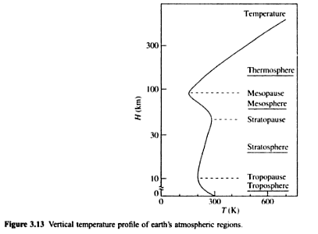
Atmospheric Chemistry

Slide 167
Atmospheric Chemistry
Troposphere – 0-12 km
Stratosphere – 12-50 km
Mesosphere – 50-80 km
Thermosphere – 80-700 km

Slide 168
Atmospheric Chemistry
The Troposphere is mostly heated by transfer of energy from the earth surface and temperature decreases with altitude or height.
In Stratosphere temperature increases with height due to increased absorption of UV radiation by Ozone Layer.

Slide 169
Atmospheric Chemistry
In Mesosphere temperature decreases with height due to decreasing solar heating.
In Thermosphere temperature increases with height due to absorption of highly energetic solar radiation which causes atmosphere particles in this layer to become electrically charged.

Slide 170
Air Pollution
Criteria Pollutants:-
The criteria pollutants as defined by USA, EC(European Community) & WHO includes CO,NO₂,SO₂,Pb,PM-10(Particulate Matter of dia less than 10µm)
These are generally found in urban environment.

Slide 171
Air Pollution
Non-Criteria Pollutants:-
The non-criteria air pollutants are those for which emission limits from industry are set or fixed.
These are more poisonous & hazardous w.r.t. criteria pollutants
Ex:- Benzene(C₆H₆),Carbon disulphide(CS₂), Arsenic, Asbestos

Slide 172
Air Pollution
Acid Deposition:-
Rainwater has P^{H} approximately 5.7 & rainwater having P^{H} less than this will be treated as acid rain, which will be a reason for acid deposition on the earth.
Hydrocarbon(HC),SO_{X},NO_{X} emitted from industries & vehicles are the main source of acid deposition.

Slide 173
Air Pollution
GHG(Green House Gases):-
A GHG absorbs & emits radiation within the thermal infrared range having wavelength between 700nm to 1mm i.e.
700x10⁻⁹ m to 10⁻³m
The major GHG in order of their contribution are CO₂>CFCs>CH₄>N₂O(Nitrous Oxide)

Slide 174
Air Pollution
Air Pollution Meteorology:-
The meteorological factors are –
Wind speed & direction
Temperature & humidity
Turbulence
Atmospheric Stability
Topographic effects on meteorology

Slide 175
Air Pollution
Scales:-
Air pollution emission can be measured in 3 scales-
a) Microscale
b) Mesoscale
c) Macroscale

Slide 176
Air Pollution
a) Microscale:-
It is of the order of 1km & duration is minutes to hours.
Ex:- Chimney gases

Slide 177
Air Pollution
b) Mesoscale:-
It is of the order of 100km & duration is hours to days.
Ex:- Mountain valley wind

Slide 178
Air Pollution
c) Macroscale:-
It is of the order of 1000km & duration is days to weeks.
Ex:- wind over oceans & continents

Slide 179
Air Pollution
Wind Speed:-
Wind speed at any height(z) can be determined using power law relationship i.e.
U_{Z}=U₁₀(Z/Z₁₀)^{P}

Slide 180
Air Pollution
Where,
U_{Z} is wind speed at height Z mtr
U₁₀ is wind speed at 10mtr height
Z is height in mtr
Z₁₀ is 10 mtr height
P is exponent depends on terrain & stability class

Slide 181
Air Pollution
Q. Use power law velocity profile equation to determine U₂₀,U₅₀,U₁₀₀,U₂₀₀ if U₁₀ is 5m/sec & p is 0.2.

Slide 182
Air Pollution
Lapse Rate:-
In the lower troposphere, the temperature usually decreases with altitude.
The rate of temperature change or gradient is known as the lapse rate.
Lapse rate can be ambient or adiabatic.

Slide 183
Air Pollution
Ambient Lapse Rate (ALR) or
Environmental Lapse Rate(ELR):-
The temperature change or gradient with respect to rising altitude is known as ambient lapse rate & it varies from day to day & day to night.
This is the actual change of temperature with altitude for the stationary atmosphere.

Slide 184
Air Pollution
Adiabatic Lapse Rate:-
The temperature change of a parcel of air against rising altitude under adiabatic condition (i.e. occurring without the addition or loss of heat) is called the adiabatic lapse rate.

Slide 185
Air Pollution
Adiabatic Lapse Rate can be of two types-
i) Dry Adiabatic Lapse Rate(DALR)
ii) Moist adiabatic lapse rate (MALR) or
Saturated adiabatic lapse rate(SALR)

Slide 186
Air Pollution
For dry air i.e. DALR value is 0.98⁰C per 100mtr or approximately 1⁰C per 100mtr or 10⁰C per KM height
For moist air i.e. MALR value is 0.55⁰C per 100mtr or approximately 0.6⁰C per 100mtr or 6⁰C per KM height.

Slide 187
Air Pollution
Atmospheric Dispersion:-
For determining atmospheric dispersion, generally 5 models are used like –
Gaussian model
Numerical model
Statistical model
Emperical model
Physical model

Slide 188
Air Pollution
Out of the above models, Gaussian model is generally used.
The various assumptions of Gaussian model are –
i) There is no variation in wind speed & direction between the source & receptor.

Slide 189
Air Pollution
ii) All discharges remain in the atmosphere.
iii) Dispersion doesn’t occur in the downward direction.
iv) Emission rates are assumed constant & continuous.

Slide 190
Equipment Selection & Design
The Equipment Selection & Design is made on the basis of the types of compounds which are required to be removed.
Generally, compounds can be of three types –
a) Volatile Organic Compounds(VOCs)
b) Inorganic Compounds
c) Particulate matter

Slide 191
Equipment Selection & Design
The major types of equipments which are used are –
i) Incinerators
ii) Absorbers
iii) Adsorbers
iv) Condensors
v) Filters

Slide 192
Equipment Selection & Design
vi) Scrubbers or wet collectors:-
It is an apparatus using water or solution for purifying gases or vapours
vii) Various particle collection devices like ESP(Electrostatic Precipitator)
viii) Impingement separators:-
By density difference, it separates solids from gases

Slide 193
Equipment Selection & Design
ESP:- An electrostatic precipitator (ESP) is a highly efficient filtration device that removes fine particles, like dust and smoke, from a flowing gas using the force of an induced electrostatic charge minimally impeding the flow of gases through the unit.

Slide 194
Equipment Selection & Design
Basic Working Principle of ESP:-
In high- voltage electrostatic field, affected by the electric field force, gas ionization takes place. There are tremendous amount of electrons and ions existing in the ionized gas. After the dust particles are combined with these electrons and ions, they will be polarized, most of them are negatively polarized. Under the action of the field force, negatively charged particles migrates towards the positive electrode and in turn release electrons and attach to the positive electrode.

Slide 195
Equipment Selection & Design
When the particles agglomerate and the layers reaches a certain thickness on the plate, rapping system will start to work and the particles will be dislodged from the collecting plate by vibration and falling into the hopper. That ends the collection process.

Slide 196
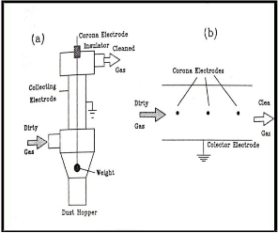
Diagram

Slide 197
Equipment Selection & Design
The efficiency of an ESP with plate collector is given by Anderson-Deutsch equation which can be expressed as follows:-
Efficiency = 1- e^{(-AW/Q)}
where, A = area of the plates in square mtr
W= particle sedimentation velocity in an electric field in mtr/sec
Q= Gas flow rate in m³/sec

Slide 198
Problem
A quantity of 50 m³/sec of air flows from a cement manufacturing facility. It contains cement particles whose settling velocity is 0.12 mtr/sec. If 99% removal efficiency is required, calculate the surface area of the ESP or design an ESP.

Slide 199
Problem
Calculate the percentage increase in area of the ESP plates, if the efficiency of the ESP unit is to be increased from 99% to 99.7%. Given the flow rate is 50m³/sec & particulate velocity is 0.15mtr/sec.

Slide 200
Problem
The drift velocity of fly ash particle is given by the empirical equation w= 1.5X10⁵ d_{p}, where d_{p} is particle size. Determine the plate area required to remove particles of dia 0.7µm with removal efficiency 95%. Flow to ESP is 5m³/sec.

Slide 201
Noise Pollution
Sounds are mechanical waves of pressure which allow us to hear & listen.
Sounds can be transmitted through solid, liquid & gas.
Generally human beings can perceive sound frequencies between 20 Hz & 20 KHz.

Slide 202
Noise Pollution
Noise is a sound, that is loud, unpleasant, unexpected or undesired.
Sounds, particularly loud ones, that disturb people or make it difficult to hear wanted sounds, are called noise.
Noise is a subset of sound.

Slide 203
Sources of Noise Pollution
Sources can be classified into outside & inside.
Outside include construction sites, road traffic, airport, factories etc.
Inside include phones, tv, radio, home appliances etc.
Main source is urbanization & increasing population.

Slide 204
Sources of Noise Pollution
  Source Sound in dB
  Normal conversation 60
  Alarm Clock 80
  Car horn 120
  Jet 130
  Gunshot 140
  Rocket Launching 180

Slide 205
Effects of Noise Pollution
Sleep disturbance
Lack of productivity
Causes stress & depression
Hormone imbalance
Higher heart rate

Slide 206
Noise Control or Attenuation
Noise has following medium.
Source→Transmission Path →Receiver
The acoustic treatment of above three can help in attenuation.

Slide 207
Ways to reduce Noise Pollution
Wear ear plugs
Avoid using multiple appliances at a time
Keep vehicles & machines in proper condition
Buildings can be designed with suitable noise absorbing material for the walls, windows, and ceilings.
Social awareness programs should be taken up to educate the public about the causes and effects of noise pollution.

Slide 208
Physical Properties of Sound
The various physical properties of sound are –
Amplitude(A)
Wavelength(λ)
Time Period(T or P)
Frequency(f)
Speed of sound(c)

Slide 209
Physical Properties of Sound
Amplitude is maximum or minimum pressure
Wavelength is the distance between successive crest or trough
Time period is the time gap between successive crest or trough
Frequency is the number of complete pressure variations or cycles per second.
Speed of sound is 340m/sec.

Slide 210
Noise Criteria
The various noise criteria can be –
L_{Aeq} ( Equivalent Continuous Level)
L_{AE} (Sound Exposure Level)
L_{AN} (Sound Level Exceeded for N% of time)

Slide 211
Indian Standard for ambient noise level
Area code Area Daytime Nighttime
A Industrial Area 75dB 70dB
B Commercial Area 65dB 55dB
C Residential Area 55dB 45dB
D Silence Zone 50dB 40dB
The above values are of L_{Aeq}.

Slide 212
Inverse Square Law of sound Propagation
It states that, the sound intensity(I) is inversely proportional to the square of the distance (r) it propagates.
I= W/4πr² i.e.
Iα1/r²,
where, W is Sound power of noise source in watt.

Slide 213
Formula
The sound power level is measured in decibel(dB) i.e.
L_{W}=10 log(W/10⁻¹²)
where, L_{W} is sound power level in dB for 10⁻¹² watt & W is sound power of noise source in watt.

Slide 214
Formula
The sound pressure level is measured in decibel(dB) & is directly proportional to the square of sound pressure i.e.
L_{P}=10log{P²/(P₀)²}
= 20 log (P/P₀)
where L_{P} is sound pressure level in dB,
P is measured pressure in Pascal &
P₀ is reference pressure = 20μPa

Slide 215
Problems
Q.1. The sound from a voice shouting source is 0.001W. What is the sound power level?
Q.2.If a sound source has a pressure of 2000μPa at 10mtr distance, calculate
a) Sound Pressure Level in dB
b) Sound Intensity in Watt/m²
c) Sound Power in Watt.

Slide 216
Problems
Q.3.If two sound sources have equal pressure of 2000μPa, then determine the sound pressure in dB.
Q.4. An air conditioner generates a noise level of 75dB for five minutes in every hour. If the background noise level is 55dB, then calculate the L_{Aeq}.

Slide 217
Waste Minimization
Waste minimization is necessary :-
i) To control pollution
ii) To decrease the depletion rate of resources
ii) To increase efficiency & hence profitability

Slide 218
Waste Minimization
Elements of a waste minimization strategy:-
It includes –
i) Reduction at source
ii) Recycle/ Reuse
iii) Treatment
iv) Disposal

Slide 219
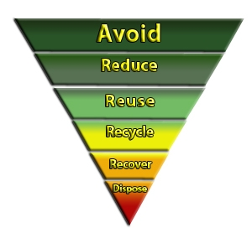
Waste Minimization Hierarchy

Slide 220
Waste Reduction Techniques
It has four major categories:-
i) Inventory Management
ii) Production Process Modification
iii) Volume Reduction
iv) Recovery

Slide 221
Waste Reduction Techniques
i) Inventory Management:-
Inventory means a detailed list of articles, goods, property.
Inventory management includes –
a) Inventory Control
b) Materials Control

Slide 222
Waste Reduction Techniques
ii) Production Process Modification:-
It includes –
a) Operational & maintenance procedures
b) Materials Change
c) Process equipment modification

Slide 223
Waste Reduction Techniques
iii) Volume Reduction:-
It includes –
a) Source Segregation
b) Concentration

Slide 224
Waste Reduction Techniques
iv) Recovery:-
It includes –
a) on-site
b) off-site

Slide 225
Life Cycle Assessment(LCA)
LCA is an useful environmental management tool.
Any product may have the following stages in it’s lifecycle –
i) Raw material acquisition
ii) Bulk material processing

Slide 226
Life Cycle Assessment(LCA)
iii) Engineered & specialty materials production
iv) Manufacturing & assembly
v) Uses & services
vi) Retirement or expired
vii) Disposal

Slide 227
Life Cycle Assessment(LCA)
LCA has the following phases –
i) Planning
ii) Screening
iii) Data Collection
iv) Data treatment
v) Evaluation

Slide 228
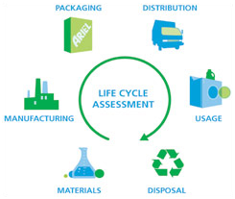
Diagram

Slide 229
Environmental Impact Assessment
Environmental Impact Assessment (EIA) is a process that requires consideration of the environment & public participation in the decision making process of project development.
Environmental Impact Assessment (EIA) is an important management tool for ensuring optimal use of natural resources for sustainable development.

Slide 230
Environmental Impact Assessment
The stages of EIA include –
i) Screening
ii) Scoping
iii) EIS preparation
iv) Review

Slide 231
Environmental Impact Assessment
i) Screening:-
By screening, it is to be decided which projects should be subject to environmental assessment.
ii) Scoping:-
It is the process which defines the key or important issues that should be included in the environmental assessment.

Slide 232
Environmental Impact Assessment
iii) EIS preparation:-
It is the scientific & objective analysis of the scale, significance & importance of impacts identified.
iv) Review:-
The review panel guides the study & then advises the decision makers.

Slide 233
Environmental Impact Assessment
Origin of EIA:-
All ecosystems including human beings have threshold of tolerance for pollution & disturbances, beyond which the system may suffer anything from temporary upsets to complete destruction. After second world war industrial & agricultural practices began to cause environmental damage which crossed the thresholds & lead to origin of EIA.

Slide 234
Environmental Impact Assessment
EIA Procedure:-
There are generally three options for establishing EIA procedures.
i) Legislative Option i.e. Legal approach
ii) Middle Ground Option i.e. within accepted planning & Procedures
iii) Policy Option i.e. within the administrative policy of government

Slide 235
Environmental Impact Assessment
Project Screening for EIA:-
The success of EIA depends on effective coverage & application of projects. The various methods commonly used to select projects for EIA are –
i) The use of positive (EIA required) & negative (EIA not required) list

Slide 236
Environmental Impact Assessment
ii) The use of project criteria
iii) The sensitive area criteria
iv) Matrices
v) Initial Environmental Evaluation(IEE)

Slide 237
Environmental Impact Assessment
Initial Environmental Evaluation(IEE):-
IEE is a mini EIA.
It requires a description of the environment & the development & the identification of environmental impacts those are anticipated.

Slide 238
Environmental Impact Statement(EIS)
EIS is a review document prepared for assessment in the EIA process.
Scope Studies of EIS:-
Scoping is the procedure for establishing the TOR(Terms Of Reference) for the EIS.

Slide 239
Environmental Impact Statement(EIS)
In general, the objectives would be to identify the concerns & issues those need attention, necessary for public involvement & to prepare a detailed report for the investigation of specific issues associated with the development.

Slide 240
Environmental Impact Statement(EIS)
Preparation of an EIS:-
One of the important elements of any project is the preparation of documentation to communicate the findings & conclusions of the study.

Slide 241
Environmental Impact Statement(EIS)
The value of the project is sharply diminished, if it’s findings don’t reach it’s requisite results or intended audiences.
The important points to be considered are –
i) Planning
ii) Purpose
iii) Audience
iv) Structure

Slide 242
Environmental Impact Statement(EIS)
Review of an EIS:-
The functions of the review authority includes-
i) The scope of the assessment i.e. which projects should be subjected to a full or partial EIS.
ii) General or specific guidelines & advice on the methods of EIS.

Slide 243
Environmental Impact Statement(EIS)
iii) Formulate the TOR(Terms Of Reference) & initiate a detailed EIS.
iv) Ensure that, the EIS had been adequately completed within the TOR.

Slide 244
Solid Waste Management
Solid waste is the unwanted or useless solid materials generated from combined residential, industrial and commercial activities in a given area.
Management of solid waste reduces or eliminates adverse impacts on the environment and human health and supports economic development and improved quality of life.

Slide 245
Solid Waste Management
It may be categorised according to its origin (domestic, industrial, commercial, construction or institutional); according to its contents (organic materials like plastics, rubber, food items & inorganic materials like glass, metal etc); or according to hazard potential (toxic, non-toxic, flammable, radioactive, infectious etc).

Slide 246
Solid Waste Management
A number of processes are involved in effectively managing waste for a municipality.
These include monitoring, collection, transport, processing, recycling and disposal.

Slide 247
Solid Waste Management
The order or hierarchy of solid waste management includes –
i) Waste prevention & minimization
ii) Reuse & Recycling
iii) Transformation
iv) Landfill

Slide 248
Solid Waste Management
Reuse:-
A newly purchased product is put to another use after the first use is completed.
Recycling:-
It is the processing of used materials or waste into new products to prevent waste of potentially useful materials.

Slide 249
Solid Waste Management
Properties of MSW(Municipal Solid Waste):-
The various properties of MSW includes –
i) Physical Properties of MSW
ii) Biological Properties of MSW
iii) Chemical & Energy Properties of MSW

Slide 250
Solid Waste Management
i) Physical Properties of MSW:-
The various Physical Properties of MSW are –
a) Particle Size Distribution
b) Density & Moisture Content
c) Field Capacity
d) Shear Strength
e) Hydraulic Conductivity

Slide 251
Solid Waste Management
a) Particle Size Distribution:-
Particle size is measured in terms of size of screens in mm through which wastes are passing.
This distribution will provide the information of various materials present.

Slide 252
Solid Waste Management
b) Density & Moisture Content:-
Density is mass per unit volume, which is a useful physical parameter used for separating various wastes from each other before treatment.

Slide 253
Solid Waste Management
The moisture content is expressed as mass of water vapour per unit mass of substance.
Moisture Content(%) = {(a-b)/a}X100
Where,
‘a’ is initial mass of sample &
‘b’ is mass of sample after drying

Slide 254
Solid Waste Management
c) Field Capacity (FC):-
It is the maximum percentage of volumetric soil moisture that a MSW sample will hold freely against earth’s gravity.
FC can be calculated by –
FC = 0.6 – 0.55(W/4500+W)
Where, W is overburden weight in Kg.

Slide 255
Solid Waste Management
d) Shear Strength:-
Solid wastes when compacted usually have high shearing strength & hence don’t flow on standing, but sludge has poor shearing strength & therefore very often sludge is co-disposed with MSW.

Slide 256
Solid Waste Management
e) Hydraulic Conductivity:-
Sludge in landfills tend to resist the movement of water through them due to low hydraulic conductivity, as sludge has high moisture content.

Slide 257
Solid Waste Management
ii) Biological Properties of MSW:-
Organic or biological matter in MSW is significant for the energy recovery by biodegradation.
Biodegradation can be accomplished either by aerobic or anaerobic process.

Slide 258
Solid Waste Management
The biodegradability of the organic fraction of MSW is given by –
BF = 0.83 - 0.028LC
Where,
BF is Biodegradable Fraction
LC is Lignin(organic) Content in % of dry weight
High LC will give low biodegradability.

Slide 259
Solid Waste Management
iii) Chemical & Energy Properties of MSW:-
The various steps involved in this are –
a) Proximate Analysis
b) Ultimate Analysis
c) Energy Content

Slide 260
Solid Waste Management
a) Proximate Analysis:-
It deals with the determination of moisture content(W%), volatile matter(VM%), non-combustible fraction (i.e. ash%) & Fixed Carbon(FC).
FC can be found out by –
FC=100 - W(%) - VM(%) - ash(%)

Slide 261
Solid Waste Management
FC is the solid combustible residue that remains after the material is heated & the volatile matter is ejected.

Slide 262
Solid Waste Management
b) Ultimate Analysis:-
It is the elemental analysis of essential major elements like C,H,O,N,P,S in percentage mass.

Slide 263
Solid Waste Management
c) Energy Content:-
Heating value or calorific value of MSW may be defined as the amount of heat liberated in calorie, when a gram of MSW is burnt.
It gives the amount of organic matter present in the MSW.
Generally, terms like E, H_{u}, H_{wf}, H_{awf} are used to express energy content.

Slide 264
Solid Waste Management
E is Energy Content
H_{u} is LHV(Lower Heat Value) i.e. energy received from waste as collected from site
H_{wf} is NHV(Normal Heat Value) i.e. energy received from water-free waste
H_{awf} is HHV(Higher Heat Value) i.e. energy received from ash-water-free waste

Slide 265
Solid Waste Management
H_{u} = H_{awf} x B – 2.445 x W
Where,
B is flammable fraction or combustible component
W is moisture content fraction or water content

Slide 266
Solid Waste Management
The energy content of MSW can be determined from following equations –
i) Dulong Equation
ii) Khan Equation

Slide 267
Solid Waste Management
i) Dulong Equation:-
H_{awf} =337(C )+1419{(H)-0.125(O)} +93(S) +
23(N)
Where, C, H, O, S, N are the % by weight of each element present in the material.

Slide 268
Solid Waste Management
ii) Khan Equation:-
E= 0.051{F + 3.6(CP)} + 0.352(PLR)
Where, E = Energy content,
F = % of food material by weight
CP = % of Cardboard & Paper by weight
PLR = % of Plastic & Rubber by weight

Slide 269
Solid Waste Management
Separation of MSW:-
The different major components of MSW must be separated from one & the other in order to have suitable management of MSW.
The component separation can be done at the household or at the industry i.e. at the source or at the transfer station or at the final destination, where mechanical sorting or separation is possible.

Slide 270
Solid Waste Management
Storage & Transport of MSW:-
It depends on types of collection facility available & materials present, which can be –
i) Door Step Collection
ii) Regular Roadside Collection
iii) Dustbins at market places
iv) Community Recycle bin

Slide 271
Solid Waste Management
Integrated Waste Management:-
The ideal integrated waste management plan might have following priorities –
i) Minimize all components of waste fraction.
ii) Recycle paper, cardboard, non-ferrous metals.
iii) Reuse plastics, ferrous metals, glass.

Slide 272
Solid Waste Management
iv) Compost food fraction of MSW.
v) Incinerate the remaining food waste.
vi) Landfill the remaining after proper treatment.

Slide 273
Land fill vs Open Dump
A Sanitary Landfill is a carefully engineered tract of land, designed by engineers. The system consists of a large excavated area in the ground, with a thick lining of plastic over which there is a compacted clay liner. The bottom of the pit also has a liner that helps in preventing the liquid waste (that comes out from the solid waste mostly if rainwater is soaked in the landfill) from leaking through, as it could contaminate the water supply. This liquid waste that gets collected is called leachate. The compacted garbage (or refuse) is then added to the landfill in the form of organized layers (layers of garbage alternating with layers of soil).

Slide 274
Land fill vs Open Dump
This is done for the elimination of any unpleasant odors and to expedite the rotting or decomposition process. When the landfill is fully covered, it is further sealed by a layer of compacted clay. Moreover, a gas (methane) is often produced as the waste deteriorates due to which a system is required to collect and pump it. If this is not managed effectively, the methane gas can explode. The methane collected can be utilized to generate electricity.

Slide 275
Land fill vs Open Dump
In most Western Countries, there are different types of landfills, mainly depending on the nature of waste materials. A landfill is built for each of the garbage types like household waste, hazardous chemicals or radioactive waste, construction waste, etc.
An open dump, as the name suggests, is an open area typically outside city limits where the garbage is dumped; this usually results in very unhygienic conditions and often pollutes the groundwater nearby, from toxic chemicals leaching into the groundwater.

Slide 276
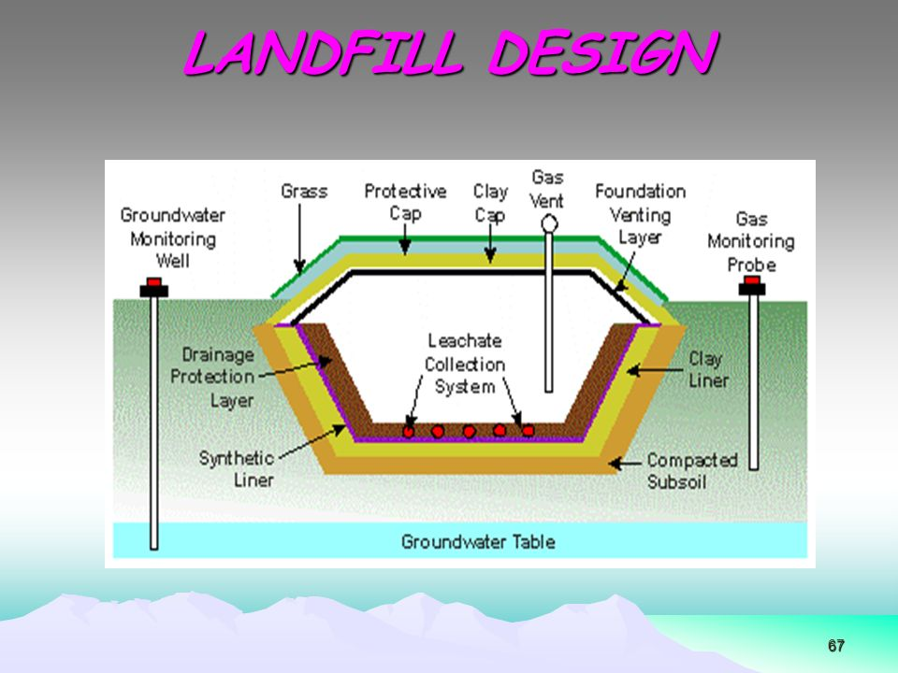
Diagram

Slide 277
Solid Waste Management
Leachate in Landfills:-
Leachate is the contaminated water in landfills which arrive at the landfill site through external precipitation.
The amount of leachate produced in a landfill depends on it’s water balance, which can be expressed as follows –
LC = PR + SRT – SRO – EP – ST

Slide 278
Solid Waste Management
Where,
LC is Leachate,
PR is Precipitation
SRT is Surface Run To i.e. water outside the site entering the landfill
SRO is Surface Run-off
EP is Evapotranspiraton
ST is Change in water storage

Slide 279
Solid Waste Management
Q. Calculate the Landfill area requirement for 20 years for a city of population of about 5 lakhs. Assume MSW generation as 500gm per capita per day & density of MSW is 500kg/m³.

Slide 280
Hazardous Waste Management
Hazardous waste is defined as, any waste which because of it’s physical, chemical quality, quantity and infectious characteristics can cause significant hazards to human health or the environment, when improperly treated, stored, transported or disposed.

Slide 281
Hazardous Waste Management
A substance is hazardous, if it exhibits one or more of the following characteristics.
i) Ignitable:- The substance causes or enhances fire.
ii) Reactive:- The substance reacts with other materials & may explode.

Slide 282
Hazardous Waste Management
iii) Corrosive:- The substance destroys tissues or metals.
iv) Toxic:- The substance is a danger to health, water, food & air.

Slide 283
Hazardous Waste Management
Hazardous Category Nature of Waste
H1 Explosive
H2 Oxidiser
H3A Highly Flammable
H3B Flammable
H4 Irritant
H5 Harmful

Slide 284
Hazardous Waste Management
Generation of Hazardous Waste:-
Industry Type Hazardous Substances
Battery Cd, Pb, Ag, Zn
Electroplating Co,Cr,Cu,Zn
Printing As,Cr, Cu,Pb,Se
Textiles Cr, Cu, Organics

Slide 285
Hazardous Waste Management
Medical Hazardous Wastes :-
These are the wastes generated from hospitals, medical colleges, nursing homes, clinical laboratories & operation theatres etc.

Slide 286
Hazardous Waste Management
Medical hazardous wastes include –
i) Expired or Obsolete medicines
ii) Infectious dressing materials
iii) Pathological wastes from medical laboratories & operation theatres
iv) Wastes from dental clinics etc.

Slide 287
Hazardous Waste Management
Household Hazardous Waste:-
The household hazardous wastes come from kitchen, bathroom, garage, garden etc.
It may include –
i)Used or Exhausted batteries
ii)Chemicals like dyes, perfumes
iii)Pesticides, herbicides, used oils, lubricants etc.

Slide 288
Hazardous Waste Management
Transportation of Hazardous Waste :-
The data or information required for Transportation of Hazardous Waste are –
i) Waste Generator
ii) Composition of Waste
iii) Physical Appearance
iv) Method of Packaging

Slide 289
Hazardous Waste Management
v) ADR/RID classification
ADR means transport of dangerous goods by road
RID means transport of dangerous goods by rail
vi) UN Number(United Nation Number)

Slide 290
Hazardous Waste Management
ADR/RID classification:-
Class Item Description
1a Explosive Items
1b Items loaded with explosives
1c Detonators & similar types of goods
2 Gases, Compressed, Condensed or
dissolved under pressure
3 Flammable Liquids

Slide 291
Hazardous Waste Management
The UN numbers range from UN0001 to about UN3500 and are assigned by the United Nations Committee of Experts on the Transport of Dangerous Goods.

Slide 292
Hazardous Waste Management
UN Number Hazardous Item
1001 Acetylene Dissolved
1002 Compressed Air
1003 Liquefied air, refrigerated
1005 NH₃, dry, liquefied

Slide 293
Hazardous Waste Management
Treatment of Hazardous waste:-
i) Thermal Treatment (Incineration)
ii) Chemical Treatment (Neutralization)
iii) Physical Treatment (Filtration, Flocculation)
iv) Disposal (Secure Landfill)

Slide 294
Hazardous Waste Management
Incineration:-
Incineration can be defined as controlled high temperature oxidation of primarily organic compounds to produce CO₂ & H₂O with non-objectionable by-products.

Slide 295
Hazardous Waste Management
3 T’s of Incineration:-
i) Time
ii) Temperature
iii) Turbulence

Slide 296
Hazardous Waste Management
i) Time:-
Adequate residence time for solids for complete destruction or breaking of bonds.
It depends on feed rate, incinerator dimension & rotation speed.

Slide 297
Hazardous Waste Management
ii) Temperature:-
High enough temperature is required for destruction of hazardous waste.
iii) Turbulence:-
Sufficient turbulence with adequate air or oxygen for mixing of waste with oxygen.
This depends on rotation speed & incinerator types.

Slide 298
Hazardous Waste Management
Types of Incinerator:- (P-724-731,G.kiely)
i) Rotary Kiln
ii) Liquid injection
iii) Plasma Arc Destruction
iv) Wet Air Oxidation
V) Fluidized Bed Combustion

Slide 299
Hazardous Waste Management
i) Rotary Kiln:-
This is most common type of incinerator.
Here Chemical destruction of waste occurs.
ii) Liquid injection:-
This is for treating liquid organic waste.

Slide 300
Hazardous Waste Management
iii) Plasma Arc Destruction:-
In this case, electric arc of very high temperature is used.
iv) Wet Air Oxidation:-
It is an aqueous phase oxidation where materials are exposed to gaseous source of oxygen.

Slide 301
Hazardous Waste Management
V) Fluidized Bed Combustion:-
This is suitable for uniform types of waste.
In this case, heat transfer is very fast & uniform.

Slide 302
Rotary kiln incinerator
A rotary kiln incinerator is typically a slightly inclined rotating cylinder, with dimensions around 2 m in diameter and 10 m long, on a pilot plant scale. There is a firebrick or refractory lining inside the cylinder. The kiln can handle all sorts of wastes and hazardous wastes including solids, liquids, sludges and gases. Partially combusted gases are often passed through a secondary combustion chamber for complete combustion. By the nature of its design and construction, the three Ts of combustion are adhered here - good contact or residence time, fair degree of turbulence, and operating at a high enough temperature. A schematic diagram is below :

Slide 303
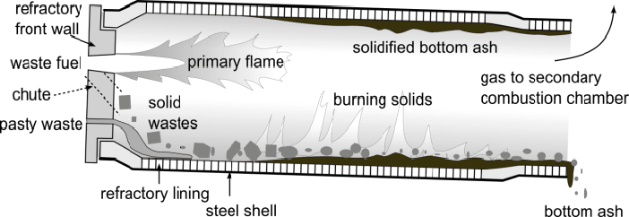
Rotary kiln incinerator

Slide 304
Hazardous Waste Management
DRE(Destruction & Removal Efficiency):-
Destruction and removal efficiency (DRE) is the efficiency of the unit (kiln) in destruction and removal of a particular targeted organic compound.
In incineration DRE of above 99% is required.

Slide 305
Hazardous Waste Management
DRE can be calculated by using the following formula –
DRE= {(W_{in} – W_{out})/W_{in}} x 100
Where,
W_{in} is mass feed rate of specific organic component to the incinerator
W_{out} is mass emission rate of same organic component from the incinerator

Slide 306
Hazardous Waste Management
CE(Combustion Efficiency):-
Combustion efficiency is a measurement of how well the fuel being burned or is being utilized in the combustion process.

Slide 307
Hazardous Waste Management
CE can be calculated by using the following formula –
CE = {(C_{CO2} – C_{CO})/C_{CO2}} x 100
Where,
C_{CO2} is concentration of CO₂ in the emitted gas
C_{CO} is concentration of CO in the emitted gas

Slide 308
Hazardous Waste Management
Q. Find out CE(Combustion Efficiency) & DRE(Destruction & Removal Efficiency) of an incinerator from the following data –
i) Input of phenolic waste is 18.2% & outlet phenol is 0.04%
ii) Outlet gas concentration of CO is 0.1% & CO₂ is 25.7%

Slide 309
Environment & Human Health
Env. Conditions Affecting Health:-
i) Cleanliness of working area
ii) Proper Lighting arrangement
iii) Sufficient Temperature & Ventilation
iv) Noise control
V) Dust control
Vi) Proper Working space & seating arrangements

Slide 310
Environment & Human Health
Factors affecting Health:-
Physical factors like unhygienic living conditions, lack of education & overcrowding in small areas lead to health problems.
Chemical factors like improper or excess use of pesticides, herbicides and exposure to toxic, hazardous and radioactive substances lead to health problems.
Climate changing factors

Slide 311
Environment & Human Health
Diseases of human and Their Control:-
Interaction of the agents like micro-organisms with the hosts like human beings and the environment can lead to various diseases.

Slide 312
Communicable Diseases & Their Control
Following three factors are important in this case.
sufficient strength of micro-organisms,
lower immunity of the person &
favouring environment for the transmission of agents

Slide 313
Communicable Diseases & Their Control
Prevention can be done by -
Enforcing immunization laws
Providing health education to all
Implementing good hand washing procedures.

Slide 314
Common Diseases
Hepatitis is inflammation of the liver and often caused by viral infection.
Typhoid is an acute illness associated with fever can be caused by bacteria salmonella typhi & spread to other people by contaminated water.

Slide 315
Common Diseases
Malaria is caused by a parasite called plasmodium which is transmitted to human beings by the bite of infected female anopheles species mosquitoes.
Dengue fever is an infection caused by dengue viruses.

Slide 316
Role of IT in Env. & Human Health
IT or Information Technology, is one of the fastest growing recent technologies & as technology is advancing, the role of IT is increasing day by day.
IT is used in the development & application of computational tools to acquire, store, organize, achieve, analyze & visualize various data which can be used for observation & protection of env. & human health.

Slide 317
Role of IT in environment
A large amount of information is easily available through remote sensing technology, GIS(Geographic Information System) & GPS(Global Positioning System) which can be used for various environmental purposes.
This data and knowledge about global environment can be used for mapping & monitoring various natural resources, thereby helping in various environmental studies.

Slide 318
Role of IT in environment
GIS helps in detecting the existence of species of flora & fauna & counting the numbers of animals like tiger, elephant etc.
MoEF(Ministry of Env. & Forest) & GOI(Govt. of India) have established ENVIS (Environmental Information System) in 1982 in different organizations for providing important information.

Slide 319
Role of IT in Human Health
IT helps in the development of biotechnology, gene engineering, research & developments in drug technologies.
IT plays a major role for a better human health in the fields like bioinformatics and online medical transcription.
IT can be used for audio, visual & data communications for medical consultation, nursing & medical education.

Slide 320
Role of IT in Human Health
IT helps in spreading awareness about endemic, epidemic & communicable diseases.
Using Remote sensing & GIS, areas which are prone to diseases like malaria, dengue etc. can be identified & accordingly steps for prevention or spreading of these diseases can be taken.

Slide 321
E-Waste
E- waste or Electrical/Electronics waste is an environment killer.
Today’s electronic gadgets, tomorrow’s electronic wastes.
'E-waste' means waste from electrical and electronic equipments; whole or in part or rejects from their manufacturing and repair process which are intended to be discarded as waste.

Slide 322
E-Waste
E-waste is the term used to cover all items of electrical and electronic equipment (EEE) and its parts that have been discarded by its owner as waste without the intent of re-use.
It is also referred to as WEEE (Waste Electrical and Electronic Equipment) or electronic waste or e-scrap in different regions.

Slide 323
E-Waste
Electronic waste or e-waste describes discarded electrical or electronic devices & used electronics which are destined for reuse, resale, recycling, or disposal are also considered e-waste.
Informal processing of e-waste in developing countries can lead to adverse human health effects and environmental pollution.

Slide 324
RoHS and WEEE directives
Companies selling electrical and electronic goods in the European Union must conform to the EU legislation for electrical and electronic equipment (EEE). The two most important directives are:
The Waste Electrical and Electronic Equipment Directive (WEEE), which sets out the responsibilities of EEE producers for the collection and recycling of their products at the end of their lifecycle.

Slide 325
RoHS and WEEE directives
The Restriction of Hazardous Substances Directive (RoHS), which bans the use of certain hazardous substances (such as lead, mercury, cadmium, hexavalent chromium and some polybrominated flame retardants) in EEE.
WEEE and RoHS Directives are complex pieces of legislation that apply to a similar range of products.

Slide 326
RoHS and WEEE directives
Each directive imposes obligations and outcomes that EU Member States must achieve. However, neither directive dictates how the Member States must fulfill their obligations. Therefore, when exporting to Europe, U.S. exporters need to be mindful that national rules for implementing each directive will differ from country to country.

Slide 327
Why E-Waste Management
It is the fastest growing portion of municipal waste & its management will prevent -
Pollution of ground water.
Acidification of soil.
Emission of toxic fumes and gases.
Release of harmful gases into the air.

Slide 328
Sources/Types of E-Waste
1. Waste generated from the products used for data processing such as computers, computer devices like monitor, speakers, keyboards, printers etc.
2. Electronic devices used for entertainment like TV, DVDs, and CD players.
3. Equipment or devices used for communication like phones, landline phones, fax etc.

Slide 329
Sources/Types of E-Waste
4. Household equipment’s like vacuum cleaner, microwave ovens, washing machines, air conditioners etc.
5. Audio, visual components such as VCRs, Stereo equipment etc.

Slide 330
E-Waste Composition(Approx.)
Monitors - 10% ,
Television -10%,
Computers,Televisions, Fax, Printers etc.-15% ,
DVD/VCR Player, CD Player, Radio etc.- 15% ,
Refrigerators -20% ,
Washing Machine, Dryers, AC, Vacuum Cleaners etc.- 30%

Slide 331
Is E-Waste hazardous?
E-Waste in itself is not hazardous.
However, the hazardous constituents present in the e-waste render it hazardous & when such wastes are dismantled & processed, they pose hazard to health and environment.

Slide 332
Reasons of E-waste generation
Advancement in technology.
Changes in style, fashion and status
Products nearing the end of their useful life
Not taking precautions while using them

Slide 333
Components of E-Waste
EEE contains various materials including hazardous, valuable and scarce metals.
Common hazardous materials found in e-waste are heavy metals (such as mercury, lead, cadmium etc.)
E-Waste also contains many valuable materials (such as iron, copper, aluminum and plastics) and
precious metals (like gold, silver, platinum and palladium) that can be recycled.

Slide 334
Components of E-Waste
In fact, up to 60 elements from the periodic table can be found in complex electronics, and many of them are recoverable, though it is not always economic to do so presently.
From the resource perspective, e-waste is a potential “urban mine” that could provide a great amount of secondary resources for remanufacture and recycling.

Slide 335
How E-Waste handled currently in India & across the world?
Around 90% of the e-waste generated in India are handled by the informal sectors.
Incineration & Landfilling are used currently for majority of e waste.
Incineration i.e. E- Waste are destroyed by burning which produces harmful gases.
Land filling which often leads to contaminate water and soil.
Very less percentage of e-waste is recycled.

Slide 336
EFFECTS OF E-WASTE ON THE ENVIRONMENT
Emissions from E-Waste create environmental damage.
Toxic chemicals from e-waste enter the "soil-crop- food pathway,“ and these are non-biodegradable and cause soil pollution.
E-Waste dumping yards and nearby places are polluted and cause health hazards.

Slide 337
EFFECTS OF E-WASTE ON HUMAN BODY
Elements present in e-waste affect human body.
Lead damage to central and peripheral nervous systems , blood systems and kidney damage and affects brain development of children.
Chromium leads to asthmatic bronchitis & DNA damage.

Slide 338
EFFECTS OF E-WASTE ON HUMAN BODY
Cadmium leads to toxic irreversible effects on human health & accumulates in kidney and liver. causing neural damage
Mercury leads to chronic damage to brain and respiratory system.
Plastics including PVC - Burning produces dioxin which can cause reproductive and developmental problems, Immune system damage & Interfere with regulatory hormones etc.

Slide 339
DISPOSAL OF E-WASTE
We should ensure safe disposal of these e-waste, because –
1. Land fill disposal allows heavy metals to leach into ground water.
2. Incineration makes hazardous materials pollute air.
3. Disposal to water is dangerous and cause water and soil contamination.

Slide 340
Methods of Recycling
Disassembly/Dismantling :
It is the systematic removal of components , parts or a group of parts or a subassembly from a product in e-waste.
Upgrading :
It includes comminuting(breaking) and separation of materials using mechanical/physical or metallurgical processing .

Slide 341
Methods of Recycling
Materials recovery :
The materials are recovered by recycling facilities. The plastic, glass, metals can be recovered by sorting them before mixing them with other waste.

Slide 342
ADVANTAGES OF RECYCLING E-WASTE
Assets recovery
Reduction of need for landfills
Resale and reuse
Creation of jobs

Slide 343
ADVANTAGES OF RECYCLING E-WASTE
E waste has emerged as one of the fastest growing waste streams world wide today.
Electronic gadgets, without proper disposal can cause environmental harm
Reuse and Recycle are more beneficial than simple disposal.

Slide 344
How to Dispose E-waste
Donate working older equipment to schools colleges or government entities in need.
If computers are out of order then return it to the manufacturers. (HCL and Wipro in India has best take back service)
Send waste goods to authorized recycling facility for proper disposal.

Slide 345
Probable Solutions
Need for stringent health standards and environmental protection laws in India
Extended producer responsibility
Import of waste under license
Producer-public-government cooperation
Awareness program, following safer and efficient methods

Slide 346
Probable Solutions
Choosing safer technology and cleaner substitute
Monitoring of compliance rules
Reduction of waste at source
Recognition to the unorganized sectors in India.

Slide 347
Probable Solutions
Designing of products using environment friendly raw items can make a change.
Government should take steps to reduce e-waste disposal.

Slide 348
E- Waste (Management & Handling) Rules 2011
E- Waste (Management & Handling) Rules 2011 were notified in 2011 and had come into force since 1st May, 2012.
In order to ensure effective implementation of E-Waste Rules, Government of India modified the above one on 23.03.2016 which has been effective from 01-10-2016.

Slide 349
E- Waste (Management & Handling) Rules 2011
These rules are applicable to every producer, consumer or bulk consumer, collection centre, dismantler and recycler of e-waste involved in the manufacture, sale, purchase and processing of electrical and electronic equipment or components.

Slide 350
E- Waste (Management & Handling) Rules 2011
Two categories of electrical and electronic equipment namely –
(i) IT and Telecommunication Equipment and
(ii) Consumer Electricals and Electronics such as TVs, Washing Machines, Refrigerators Air Conditioners including fluorescent and other mercury containing lamps are covered under these Rules.

